Slide 1
Nuclear Power Plants

Slide 2
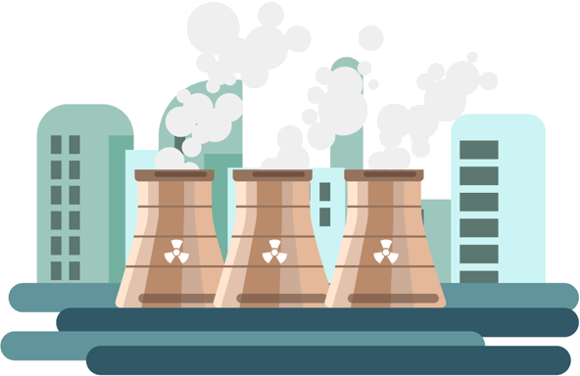
In this Smart Lesson you will learn to:
Understand how a nuclear power plant works.
Research nuclear safety.

Slide 3
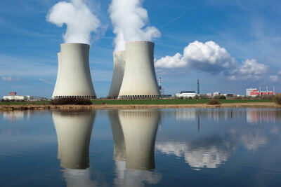
So how do nuclear power plants work?
Nuclear power plants use the energy generated by nuclear fission to generate electricity. This is done through controlled nuclear fission.

Slide 4
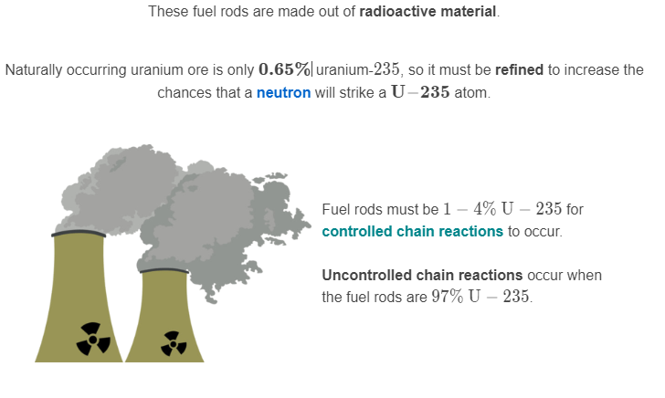
Nuclear power plants use fuel rods.

Slide 5
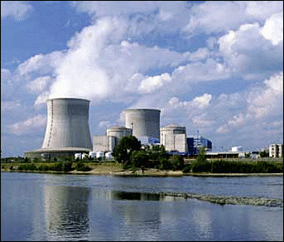
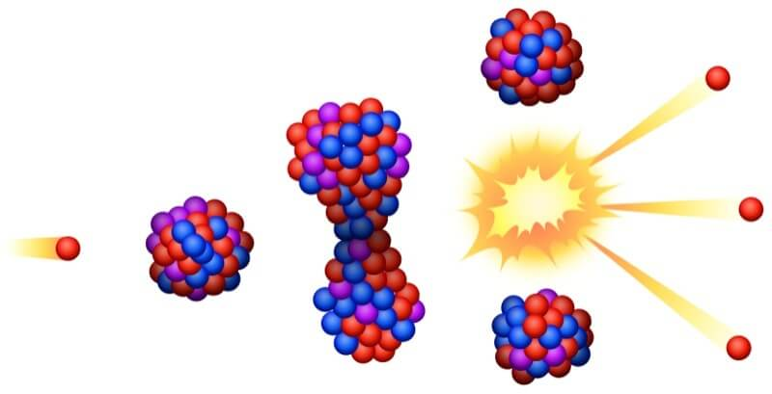
What happens in a nuclear power plant?
First, a slow neutron is fired at the fuel rod where it strikes a U−235 atom and causes nuclear fission. The neutrons released from this fission reaction are used to initiate more reactions.

Slide 6
Fast neutrons are released in nuclear fission, so a moderator is used to remove some of their energy.
This slows them down enough to be able to initiate a fission reaction.

Slide 7
Fuel rods are held within a reactor vessel.
This vessel reflects neutrons back to the fuel rods, ensuring the chain reaction can continue.
Control rods are used to control the reaction. They contain neutron poisons, such as boron-10 and absorb neutrons when they are lowered between the fuel rods.
When the rate of reaction is too low the control rods are raised, allowing more neutrons to be absorbed by U−235 atoms.

Slide 8
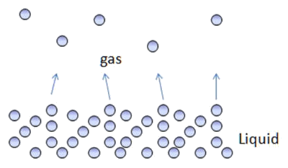
The energy generated from nuclear fission is converted into electrical energy by a steam turbine.
Nuclear fission generates heat energy, which is used to evaporate water. The steam created from this is used to drive the steam turbines, which generate electricity.

Slide 9
The Chernobyl disaster.
A nuclear power plant in Chernobyl was scheduled for routine maintenance on April 25, 1986.
However, a series of operational errors caused Reactor 4 to experience a meltdown.

Slide 10


Slide 11
What went wrong?
Reactor 4 was an old design. It had graphite-tipped moderators, water coolant and no radiation containment shields.
An operational error meant that the control rods were removed from Reactor 4, causing an uncontrolled chain reaction to occur.
The control rods were re-inserted, but the graphite tips reacted, causing an uncontrollable power surge. Within 4 seconds, the power was 100 times higher than normal levels and the temperature of the core reached 5,000∘C, which is the same temperature as the surface of the sun!

Slide 12
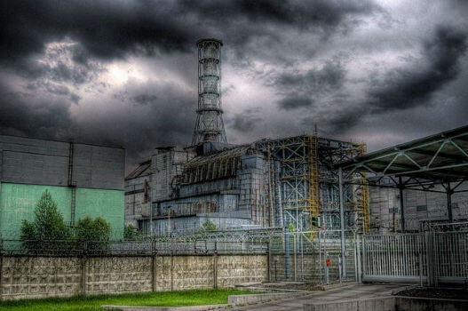
The temperature was so high that the graphite caught fire and the fuel rods ruptured, releasing radioactive fuel particles.
These fuel particles reacted with the water, causing a steam explosion which destroyed the reactor.
Since there were no containment shields, the vaporised radioactive fuel was released directly into the atmosphere.

Slide 13
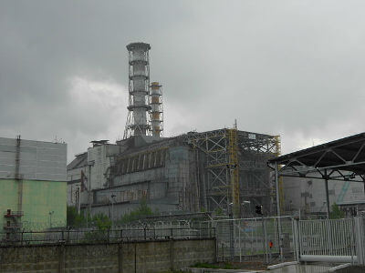
Two workers died instantly in the explosion and three more died that night.
Fifty workers died from acute radiation poisoning.
600,000 people were contaminated by radiation as a direct result of the Chernobyl disaster. At least 4000 people contaminated by radiation died from long term cancers.

